Slide 1



Run Like a Neural Network, Explain Like k-Nearest Neighbor
Keywords: XAI, CBR, Neurosymbolic, Interpretable AI
Xiaomeng Ye,
David Leake,
Yu Wang,
David Crandall

Slide 2
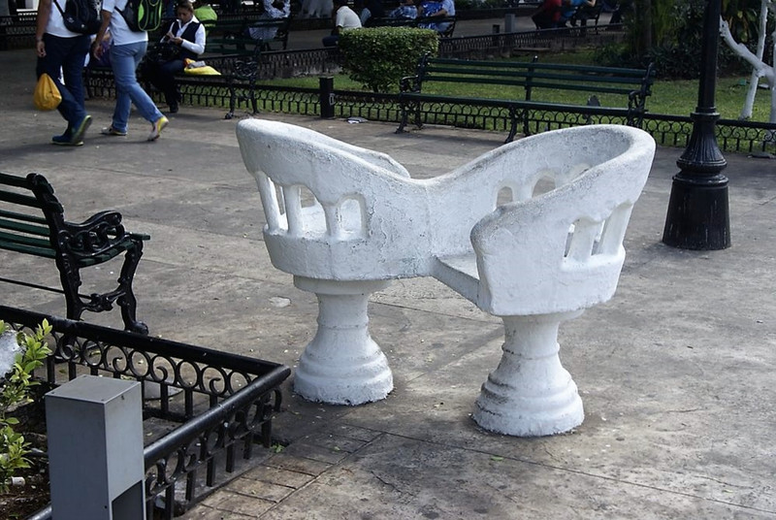
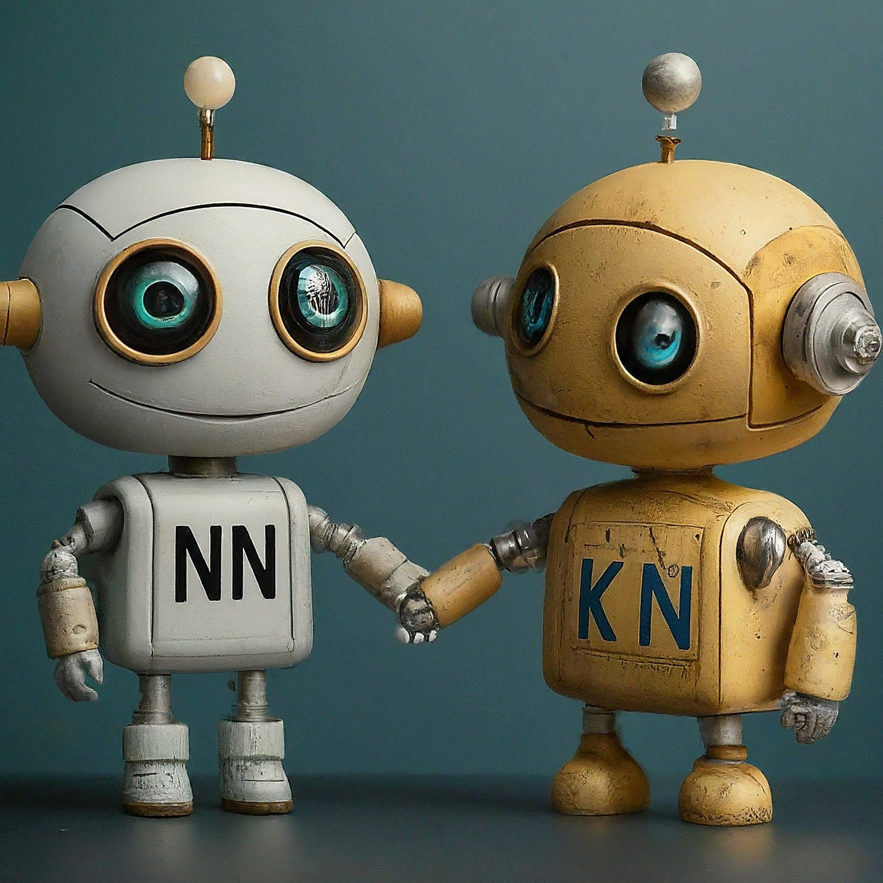
In Brief
We build a neural network that operates just like a k-nearest neighbor system. (NN-kNN)
It runs as a neural network: Trainable through backprop. Compatible with other neural models.
Its layers and nodes mimic k-nearest neighbor: Its decisions are interpreted/explained by activated cases and features.

Slide 3
Why?
Neural networks are powerful but black-box
K-NN is transparent but ill-suited to high-dimensional data
We want to combine the two and harness the strengths of both.
 | k-NN | Neural Networks
Strengths | Competitive accuracy on easy datasets; simple and transparent reasoning process. | Captures abstract patterns and feature interaction; handles large, high-dimensional data efficiently.
Limitations | Difficulty with large/high-dimensional data; performance depends heavily on metric & feature selection. | Black box. Requires post-hoc explanations, which may not reflect true reasoning.

Slide 4
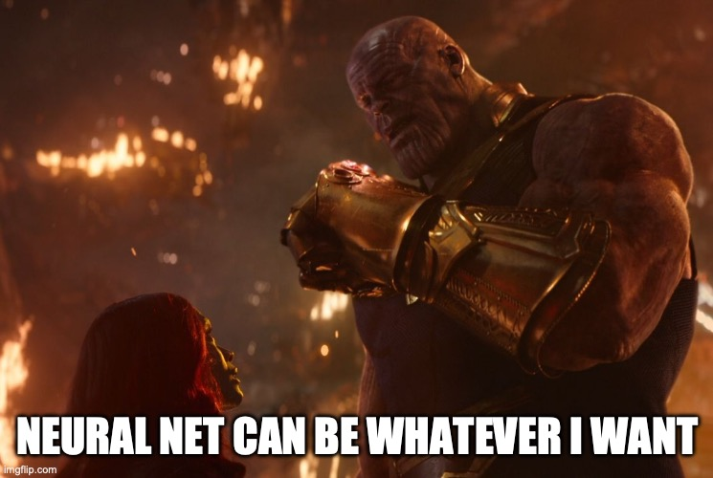
How?
Neural Nets are universal approximators. So we can emulate almost any function (with limited memory).
A good example: Logical Neural Net (Nodes represent logical operations)
We can emulate a k-NN with a NN.
We will show how it works in classification.

Slide 5
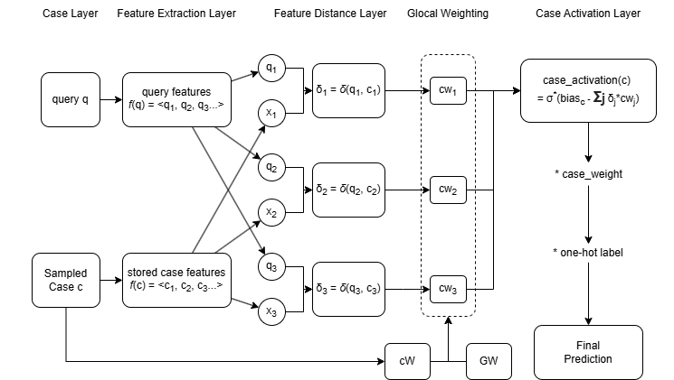
Neural Network Based K-Nearest Neighbor

Slide 6

1. Sampling cases to compare. We use equal number of cases from each class

Slide 7

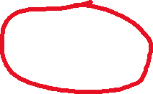
2. Extract Features. ResNet, Doc2Vec, Transformers, surface features, CNN, Bi-LSTM...

Slide 8

3. Calculate Feature Distance. Euclidean distance, cosine distance.

Slide 9

4. Weight each feature distance

Slide 10
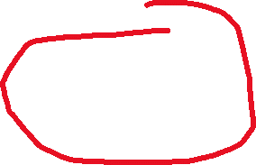
5. Calculate case activation based on distance

Slide 11
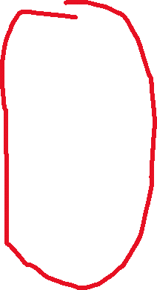
6. Activate the corresponding classes

Slide 12
Intuitive Explanation
NN-kNN is composed of:
A layer that calculates feature distances
A layer that calculates case activations using feature distances
(case activation really is just the inverse of case distance)
A layer that activates classes based on activated cases
A final layer to summarize/adapt all classes

Slide 13
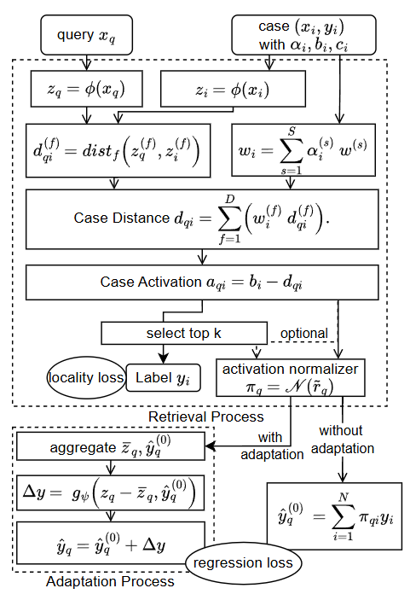
For Regression by adding:
Weighted Average
Adaptation

Slide 14
Benefits of NN-kNN
Fully intrepretable as a k-NN: Can show similar features and highly activated cases.
Powerful like a normal NN: NN-kNN is trained to minimize a loss using back propagation.
Harmonizes different components. Trained end-to-end. We can train feature weighting and case weighting together; We can balance the loss between accuracy and explainability; We can also train feature extraction, retrieval (and even adaptation) together.

Slide 15
How this relates to Winnie’s presentation

Slide 16
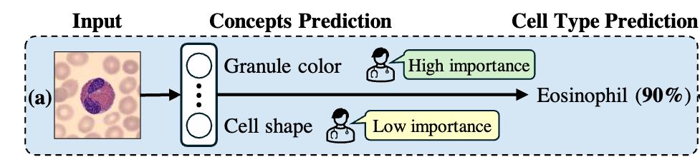
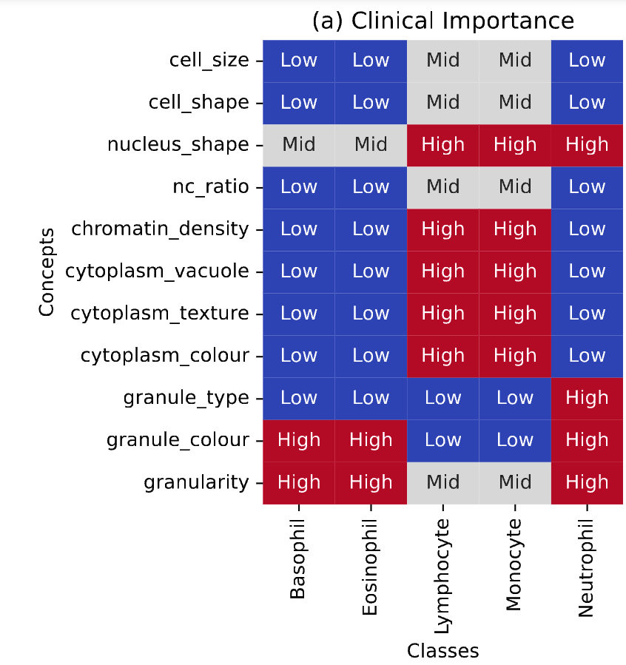

Concept-based explanation
= red
= round
Explanation: This image is an Eosinophil because its granule color is red and cell shape is round.
Each concept is treated equally .
Models do not consider the clinical importance of the concepts.
Koh, P.W., et al. Concept bottleneck models. ICML (2020)

Slide 17
My thoughts
Concept bottleneck models go from input-> concepts -> prediction
Ours: input -> cases -> prediction
Potentially, if we treat cases as if they are concepts, then the two are very similar
Also, concept-based and case-based explanation could coexist
In parallel, or in waterflow

Slide 18
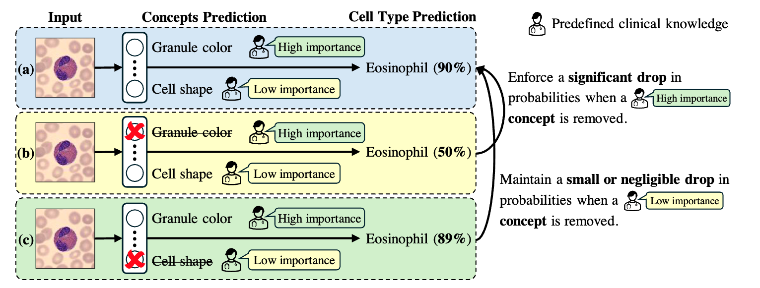
Concept-based explanation with clinical importance
W Pang, X Ke, S Tsutsui, B Wen. Integrating Clinical Knowledge into Concept Bottleneck Models. MICCAI 2024

Slide 19
We kind of are trying the same goal
We use learned feature weights and case weights to identify which features and cases are important.

Slide 20
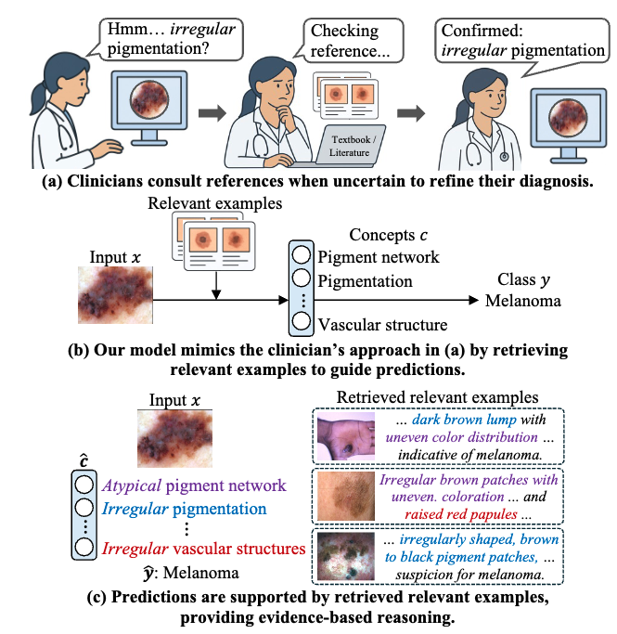
Enhancing AI models with external image-caption knowledge

Slide 21
We are thinking similarly about retrieving
Ours: Input -> Cases -> Prediction
We don’t have concepts in the middle.
Potentially a combination could work better?
Input -> Cases -> Concepts -> Prediction
Input -> Concepts -> Cases -> Prediction
Parallel

Slide 22
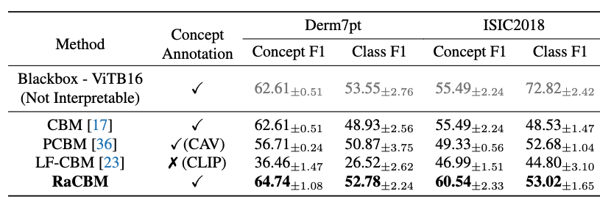
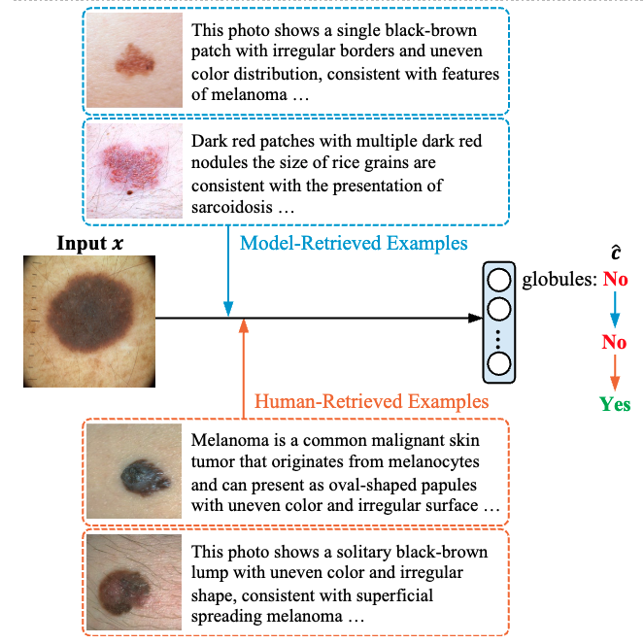
Experiments and Results
Our models outperforms other baselines on concept and class predictions.
When model-retrieved examples fail, expert can provide more relevant examples to correct the prediction (human-in-the-loop interaction).

Slide 23
intervention
We allow manual edits of feature/case weights
Normally not possible in any other neural net
But because ours is essentially k-NN, every weight has a semantic meaning.
View of Fully Interpretable and Adjustable Model for Depression Diagnosis: A Qualitative Approach

Slide 24
Key challenge: Evaluating interpretability
How do we justify that one explanation is better than others?
Reviewer Feedback:
The paper does not provide a rigorous evaluation framework to support its interpretability claims. It remains unclear how interpretability improvements are measured or validated.

Slide 25
My thought: we don’t
Cooking
How is a certain dish better? (Can only work if you are talking about a specific cuisine style)
You can’t easily compare Indian food with Nordic food (not the same ingredients, tools, etc.)
They are many kinds of explanations.

Slide 26
My thought
If we do want a rigorous quantification of goodness of an explanation
Has to be limited to a specific task, user group, using a metric that involves little subjectivity.
But this is weird too:
You don’t measure how good an Indian food is by a scoring metric, but you know if an Indian food is top-tier when you taste it.

Slide 27
Explanation can be subjective
Depends on the context, the user group, the goal:
How good is the food from the food truck? How good is the food from the street stamp? How good is the food from the high-class restaurant?
We either measure too broad a scope and has to consider many things, and be general, and risk our results not that useful
Or we measure a specific scope, for a small group of user: Confidence in diagnosing certain diseases given visual explanation of highlights.

Slide 28

Explanation can be somewhat objective
This is what I have been trying to do.
If ground-truth is known, an interpretable model can display its learned weights/biases as explanation.
We train a NN-kNN, and learn the feature importance, and check if they align with the ground truth.
We can also learn case importance, and check if the non-important cases are actually the noisy ones.
Downside: seems trivial. If only we can have a real-world example of this…

Slide 29
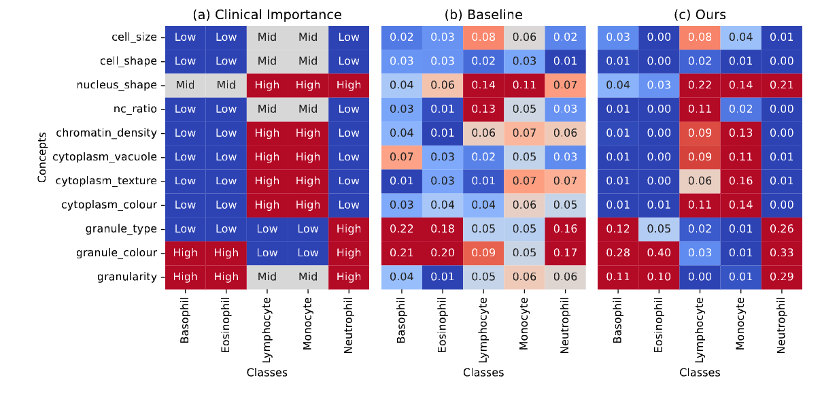
Explanation can be somewhat objective
In your work, you showed a table like this, representing human-level ground truth. I think this is measurable.

Slide 30
Rest are results can be skipped

Slide 31
Evaluation
Does NN-kNN provide accuracy comparable to other models?
Are the cases activated by NN-kNN good explanations for the model’s final decision? Potentially, NN-kNN as a neural network could make correct predictions for the wrong reasons

Slide 32
Evaluation: Simple Classification
Compared with other kNN methods: an older version of NN-kNN using either global or local weighting, a vanilla k-NN, Neighborhood Components Analysis (NCA) and Large Margin Nearest Neighbor (LMNN). NCA and LMNN can be considered as state-of-the-art k-NN methods.
Also compared to a neural net of similar complexity.
Parameter settings are in paper

Slide 33
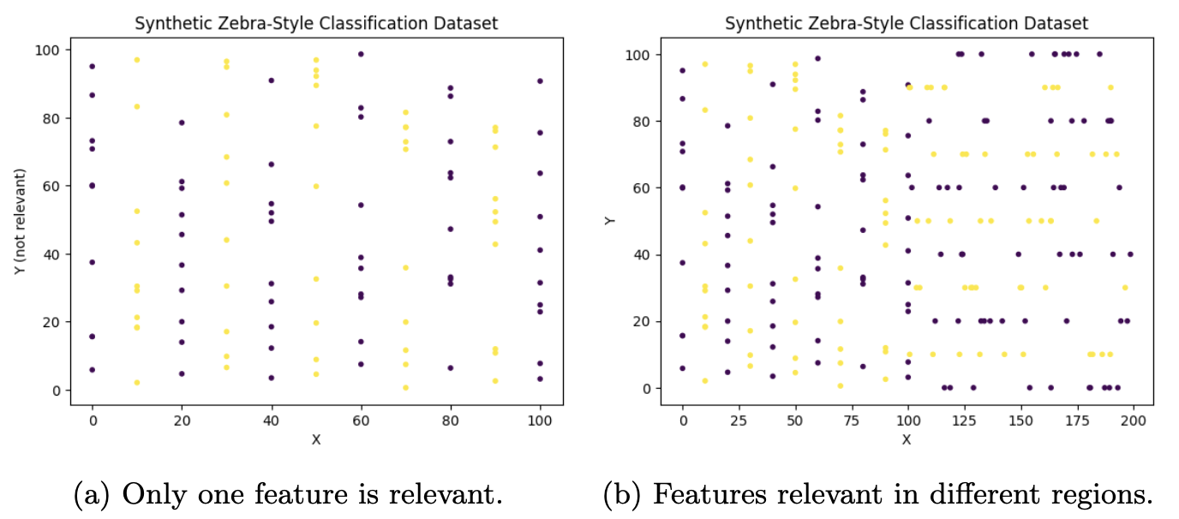
Evaluation: Simple Classification
Data sets: Sample small standard tabular data sets, for classification and regression.
Two additional generated dataset (zebra patterns shown top right)
Zebra (a), only feature X is important while Y is irrelevant
Zebra (b), X is important when X < 100, and Y is important when X > 100.
They test models' ability to learn a local weighting (local landscape).

Slide 34
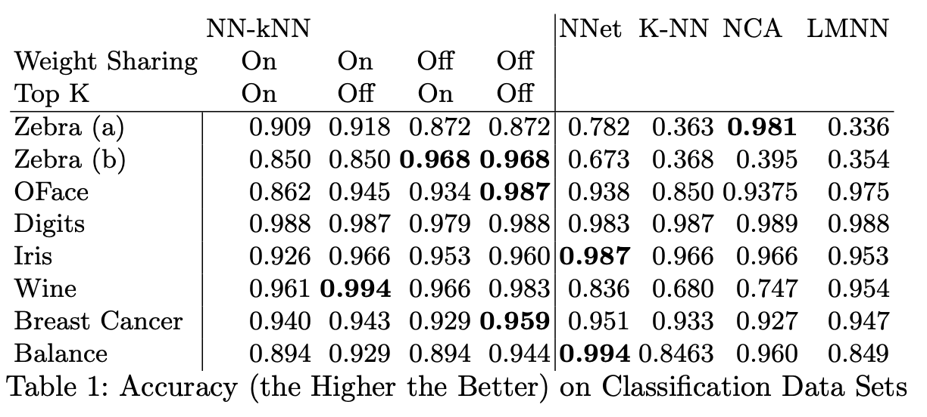
Results on classification data sets for older NN-kNN
Previous results from "Towards network implementation of cbr: Case study of a neural network k-nn algorithm"

Slide 35
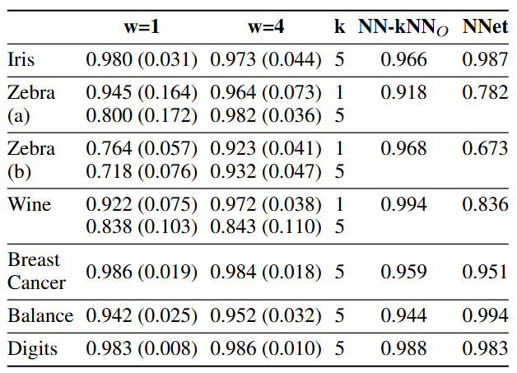
Results on classification data sets for new NN-kNN
Older NN-kNN generally outperform or on par with other models
New NN-kNN outperforms older NN-kNN
Increasing w consistently improves the performance.
The choice of k (which influenced biasc) has a significant impact on performance.

Slide 36
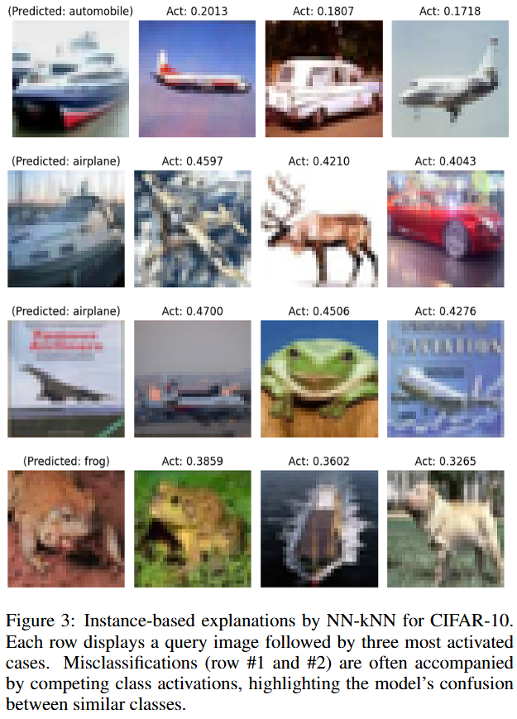
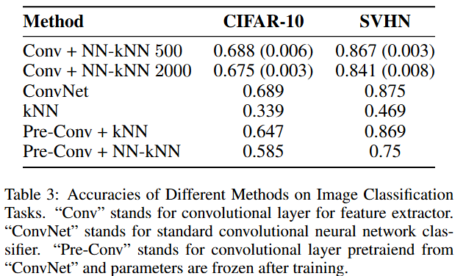
Evaluation: Image Classification

Slide 37
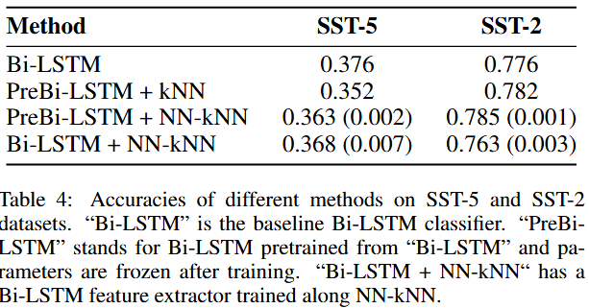
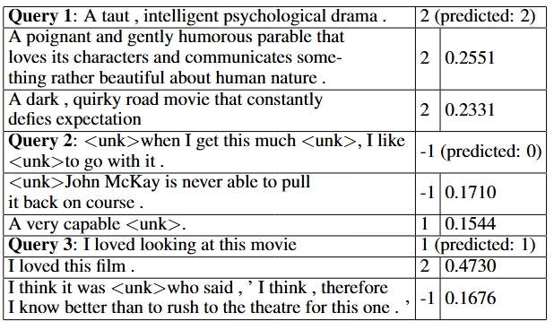
Evaluation: Movie Review Sentiment Classification

Slide 38
Discussion: The Good. NN-kNN is effective and interpretable
NN-kNN is inherently a neural network with preset neurons (in the case layer), connections (e.g. one case only activates a corresponding class) and preset-but-tunable parameters (weights and biases).
NN-kNN effectively combines general pattern knowledge (weights and bias) and symbolic case knowledge, and scales without sacrificing accuracy.
It allows benefits from both sides. For example:
Can explain with features and cases. Allow manual control/debugging with cases/features!
Allow easy incremental learning.
Easily compatible with neural methods (optimization, latent space modeling, regularization techniques)

Slide 39
Discussion: The Interesting I
For models operating on high-dimensional feature spaces, the luxury of abundant feature dimensions diminishes the utility of w. In other words: if you have very strong feature extractor, you just need one set of global feature weighting.

Slide 40
Discussion: The Interesting II
NN-kNN carries a risk of overfitting when paired with a pre-trained feature extractor, often underperforming compared to a vanilla k-NN using the same extractor.
Because pre-trained extractors are not optimized for instance-based reasoning
Notably, this risk is mitigated when the feature extractor is trained jointly with NN-kNN from scratch, ensuring better alignment with instance-based reasoning objectives.

Slide 41
Discussion: The Bad
It inherits downside from both NN and kNN.
(Meta-)Parameters needs some fine tuning.
Cases are interpretable, but the neural part is not. If using too strong a feature extractor, we black-box (part of) the white box again.
These issues are not fundamental, and solvable using techniques from both sides.

Slide 42
Take-aways
NN-kNN combines NN and kNN.
Inherits pros (and cons) of both sides.
Cases make models interpretable, and equally accurate (if not more).
NN-kNN illustrates new opportunities for network case-based reasoning.
Symbolic and Neural, at the same time. (more than just Symbolic + Neural)
One future direction is NN-kNN style RAG.

